Slide 1
Distribution Strategies

Slide 2
Reasons to distribute application
Scalability
Ease of development/maintainability
Resilience

Slide 3
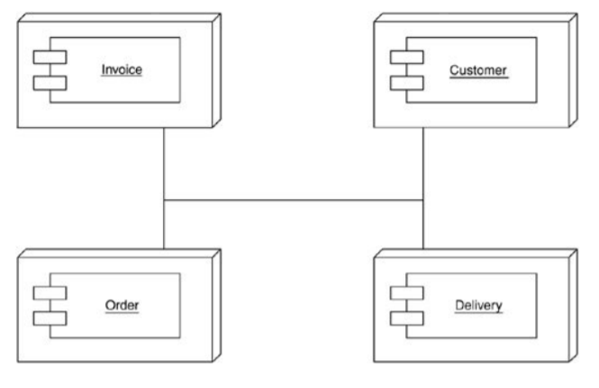
Distribution by classes
Distributing an application by putting different components on different nodes

Slide 4
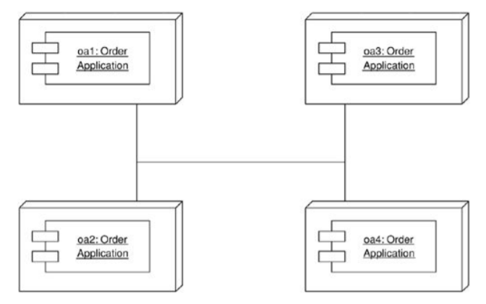
Scaling out the monolith
Scaling out by putting several copies of the same application on different nodes

Slide 5
Where you have to distribute
Client PCs – servers of business software
Server-based application software – database
Web server – application server

Slide 6
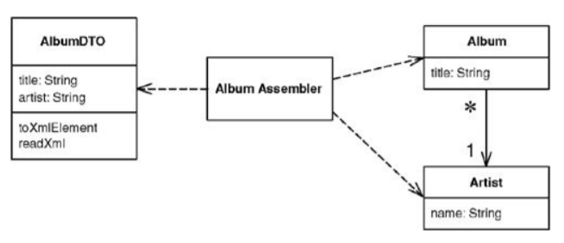
Data Transfer Object
An object that carries data between processes in order to reduce the number of method calls

Slide 7
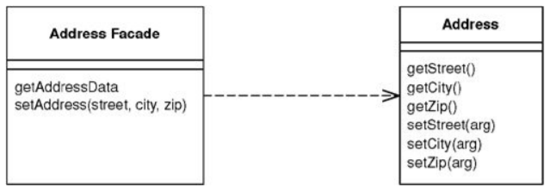
Remote Facade
Provides a coarse-grained facade on fine-grained objects to improve efficiency over a network.

Slide 8
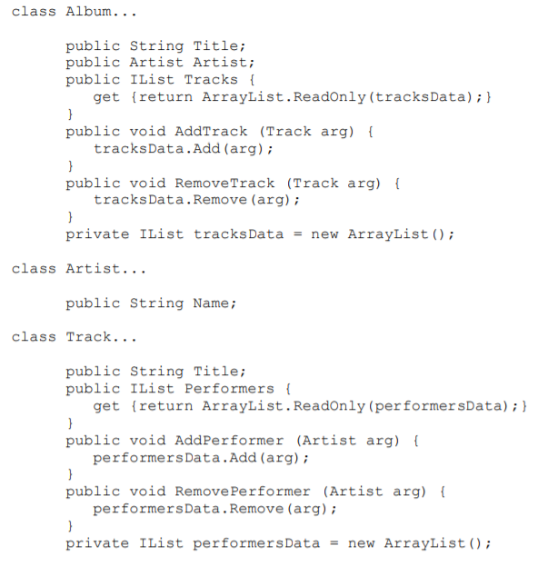
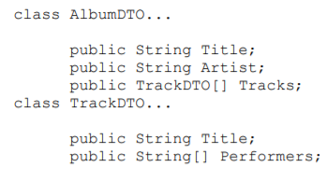
Example: Web Service
Data transfer objects
Domain model

Slide 9
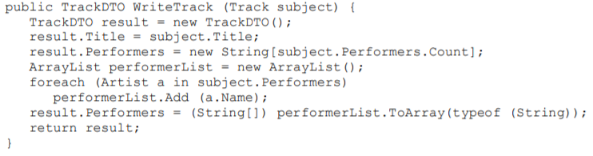
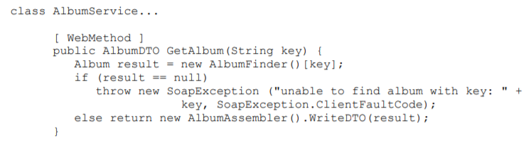
Example: Web Service
Mapping between DTO and domain model
.NET web service

